Slide 1
Selection of an Atmospheric Shading Model for Planetary Rendering
Justin Powell
Jon Denning

Slide 2
Goal of Project
To find an implementation of atmospheric scattering shading model that is both cheap to run in real time and easily modifiable for multiple worlds.
Part of a larger project to model and render planetary bodies such as Earth.

Slide 3
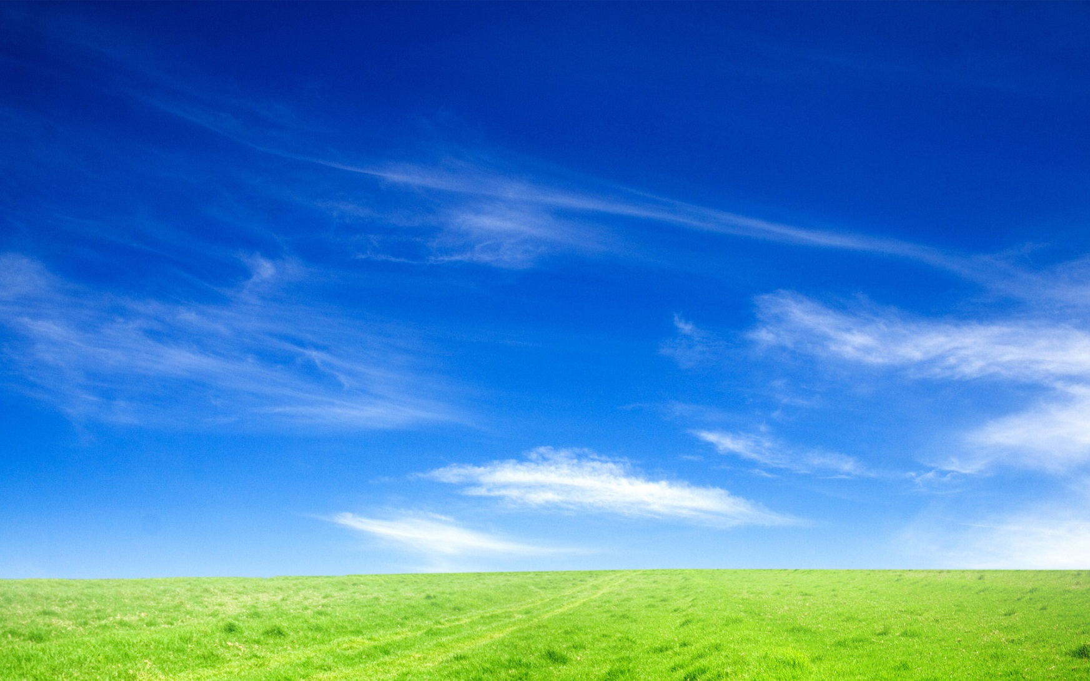
What is Atmospheric Shading?

Slide 4
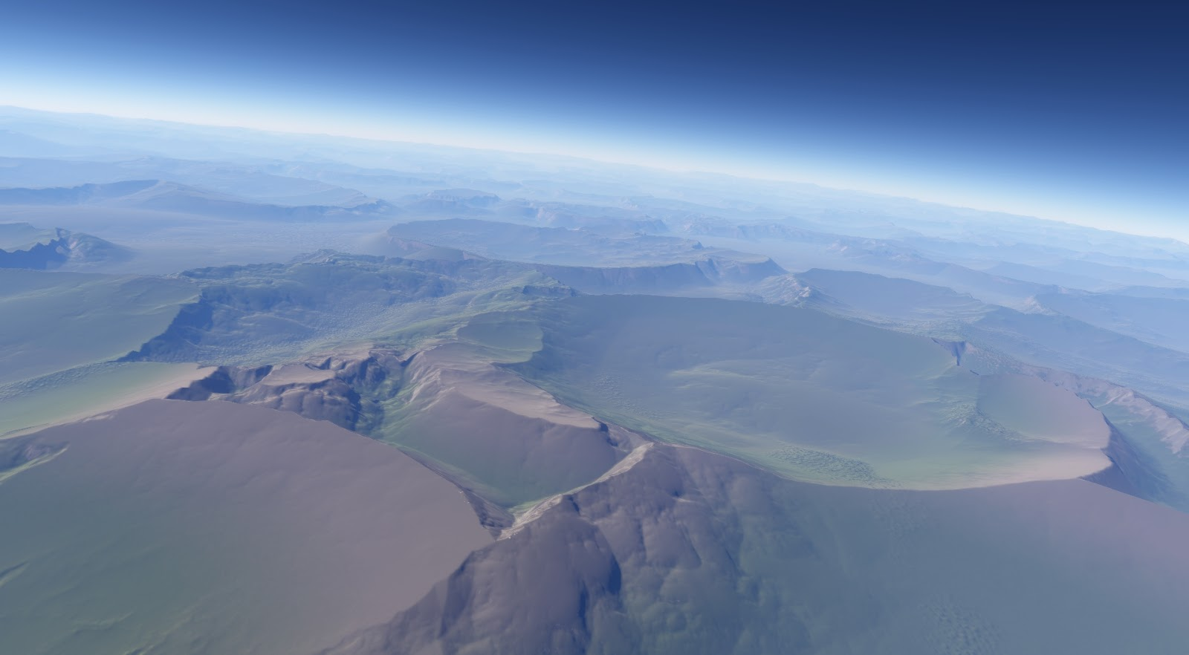

Slide 5
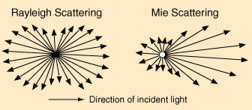
What makes the sky blue?
Rayleigh Scattering:
The effect of light waves being scattered by minute particles in the atmosphere.
Scattering is affected by wavelength of light.
Blue light scattered more over long distances than red light.

Slide 6
Contd.
Mie Scattering:
Scattering of light caused by larger particles in the air.
Scattering occurs largely in the same direction of incident light.
This causes Mie scattering to be more noticeable when looking in the direction of the Sun.

Slide 7
Considered Solutions
Nishita solution:
Describes a method for color the atmosphere when viewed from space.
Uses multiple lookup tables to calculate Rayleigh and Mie scattering based on atmosphere depth and light angle.
Also takes into account multiple atmosphere densities based on atmosphere depth.
Very calculation intensive; Expensive to run in real time.

Slide 8
Contd.
O’Neil Solution:
Based off the Nishita algorithm
Eliminates the lookup tables
Approximates the color for each vertex of the atmosphere mesh based off several simplified formulas.
Cheap to run [TODO: picture]
Easy to modify.

Slide 9
Winner: O’Neil
Reasons for selection
Remember the goal.
O’ Neil solution is less calculation intensive to run in real-time and is very simple to modify to get new results.
End results look just as good as the Nishita solution.
Simple to impelement.

Slide 10
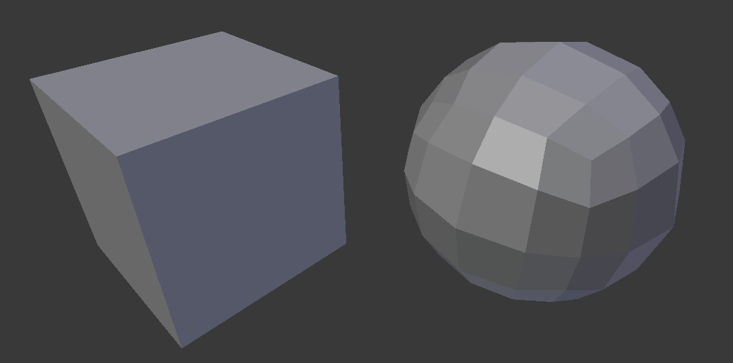
Implementation
Atmosphere mesh construction:
Two meshes used to draw atmosphere.
When looking up from within the atmosphere

Slide 11
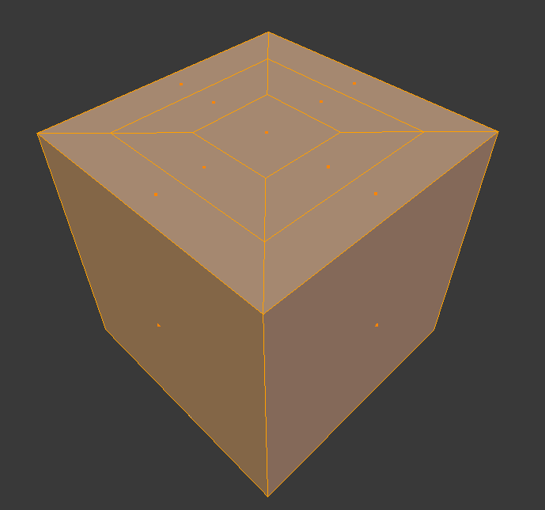
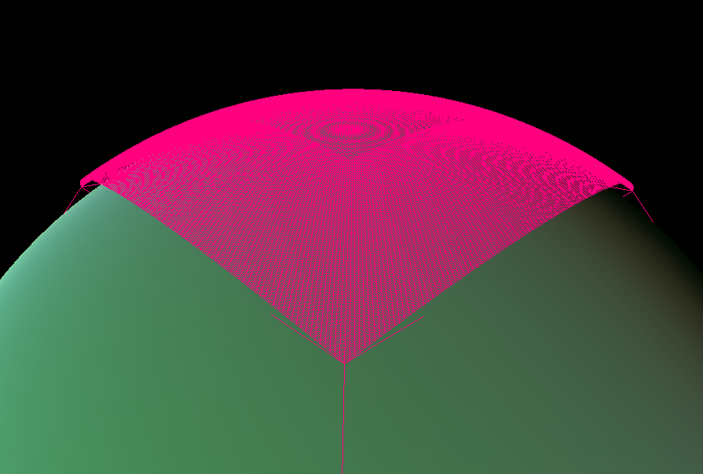
When looking down from space.

Slide 12
Contd.
Shader variables to consider:
Kr: Rayleigh coefficient
Km: Mie coefficeint
eSun: energy of the sun
nSamples: How many points to sample when calculating scattering.
invWavelength: Affects the color of light that is scattered.

Slide 13
Results
Real-time atmospheric shading
Low performance hit
Easily modified on the run
Realistic looking atmosphere shading that works for the purposes of this project
Easily implemented and can be reused.

Slide 14
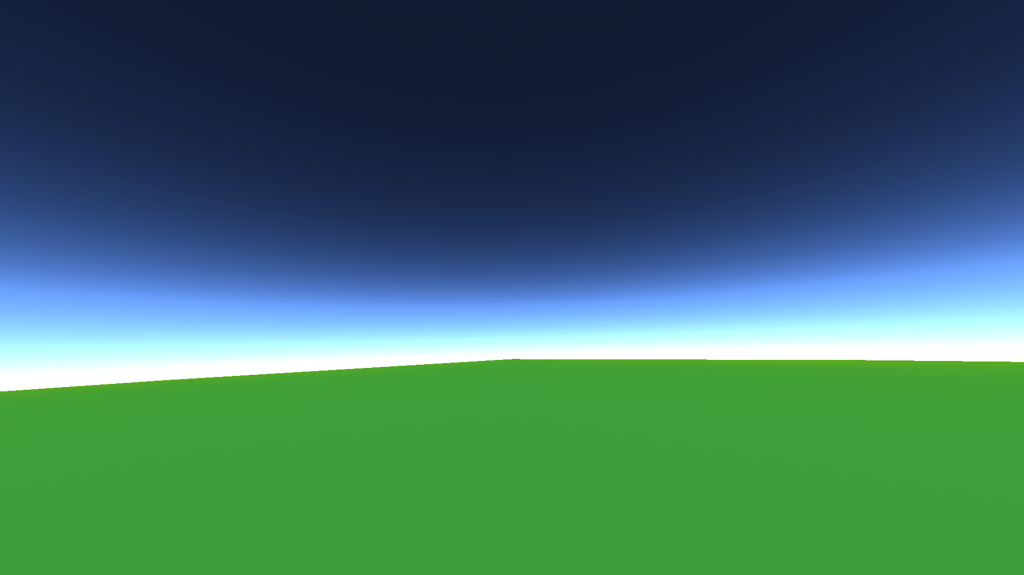

Slide 15
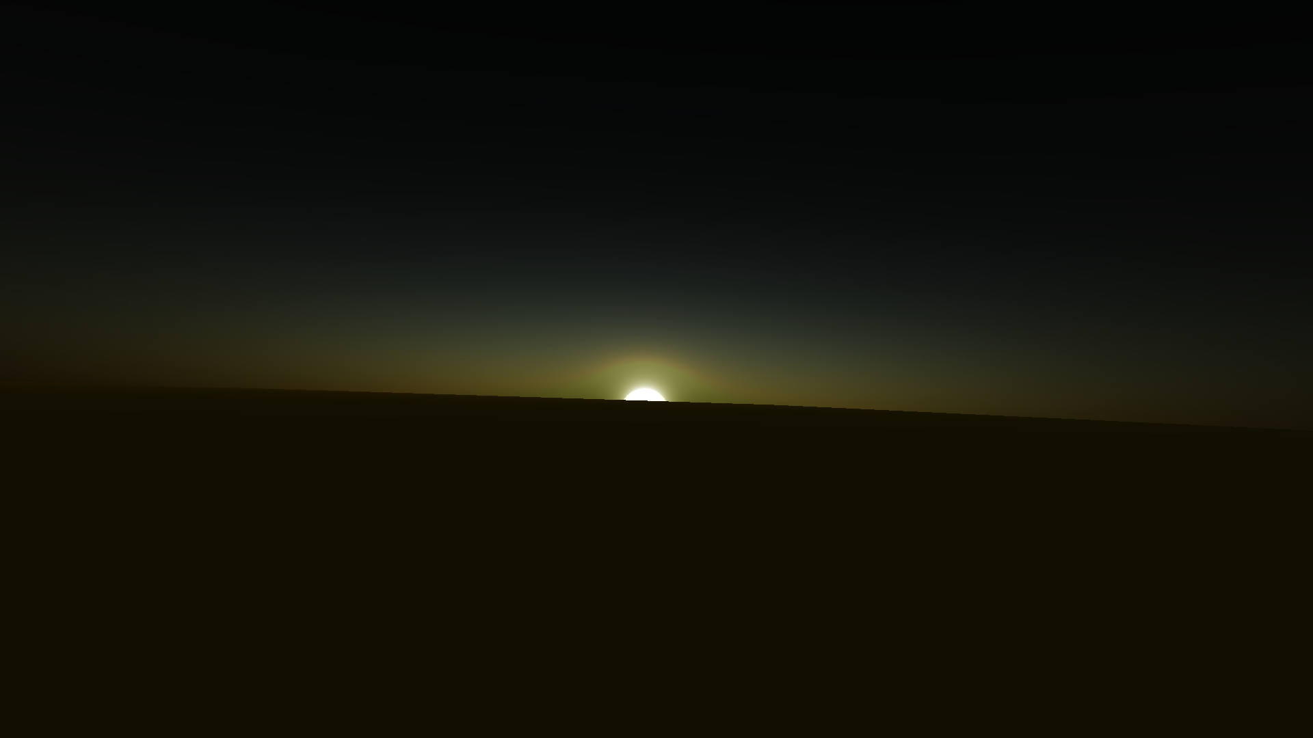

Slide 16
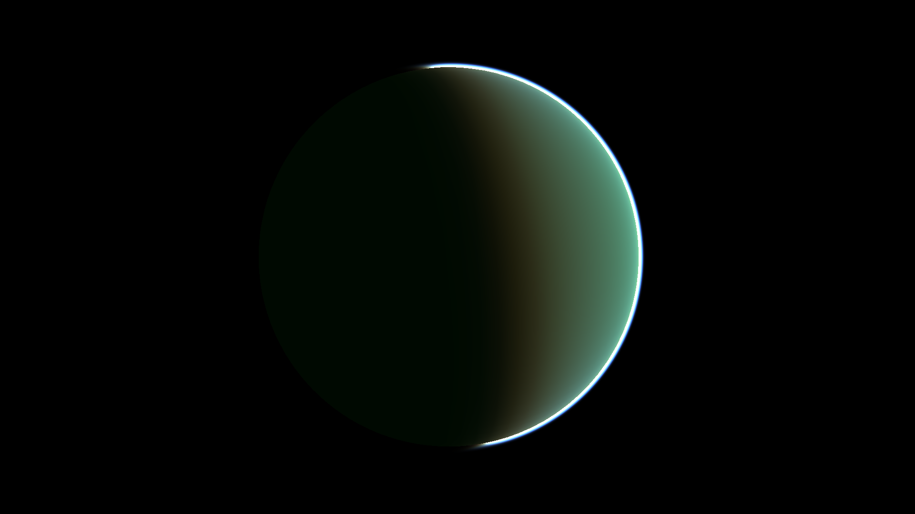

Slide 17
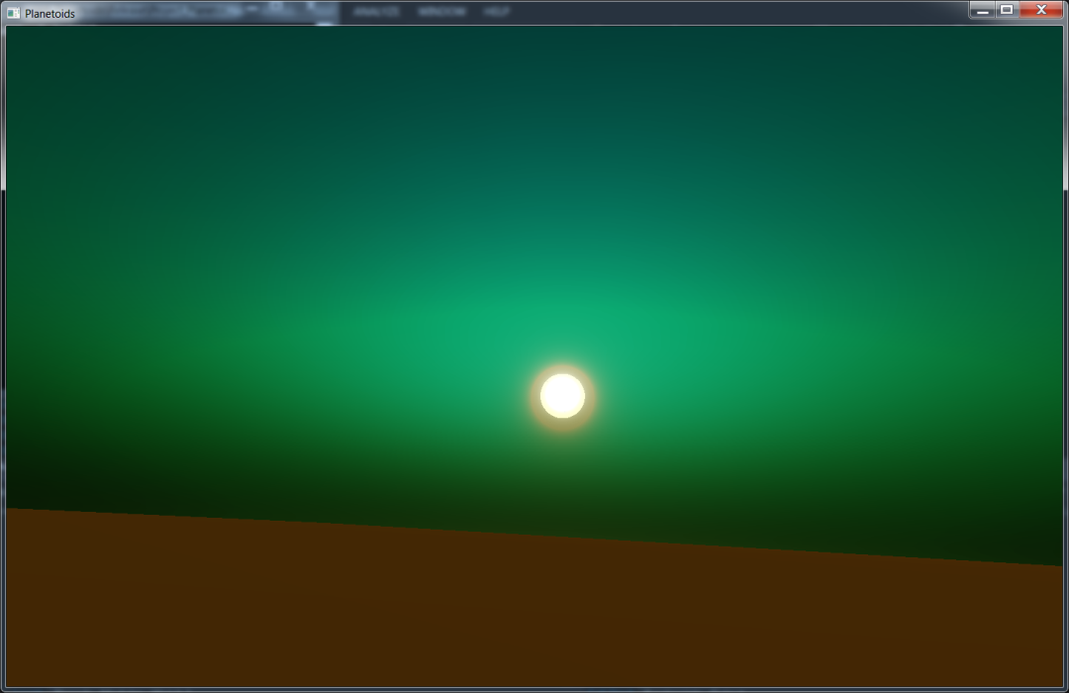
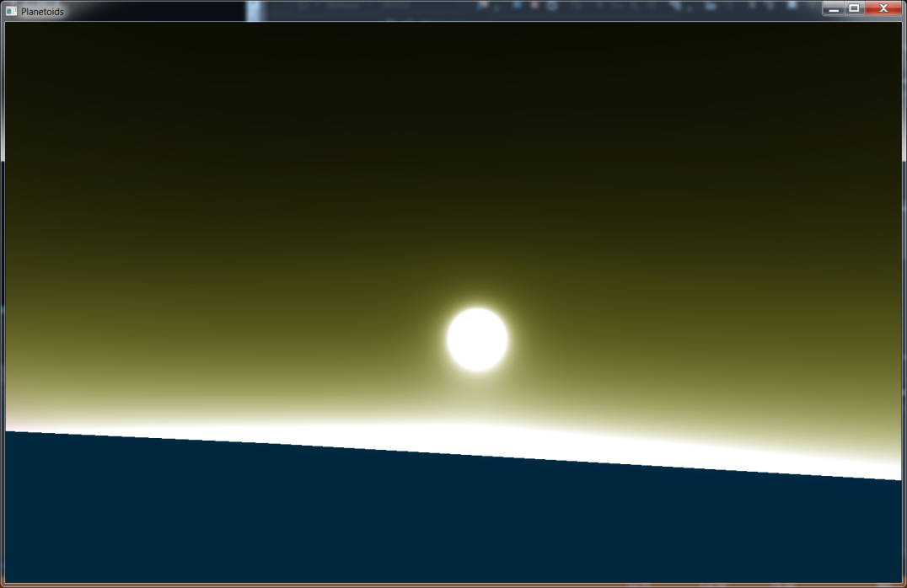
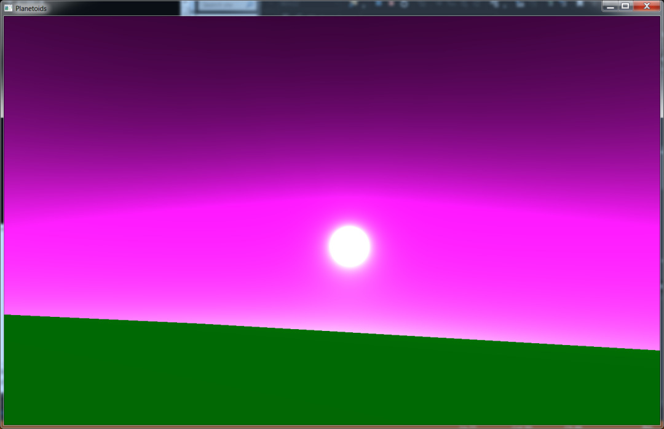
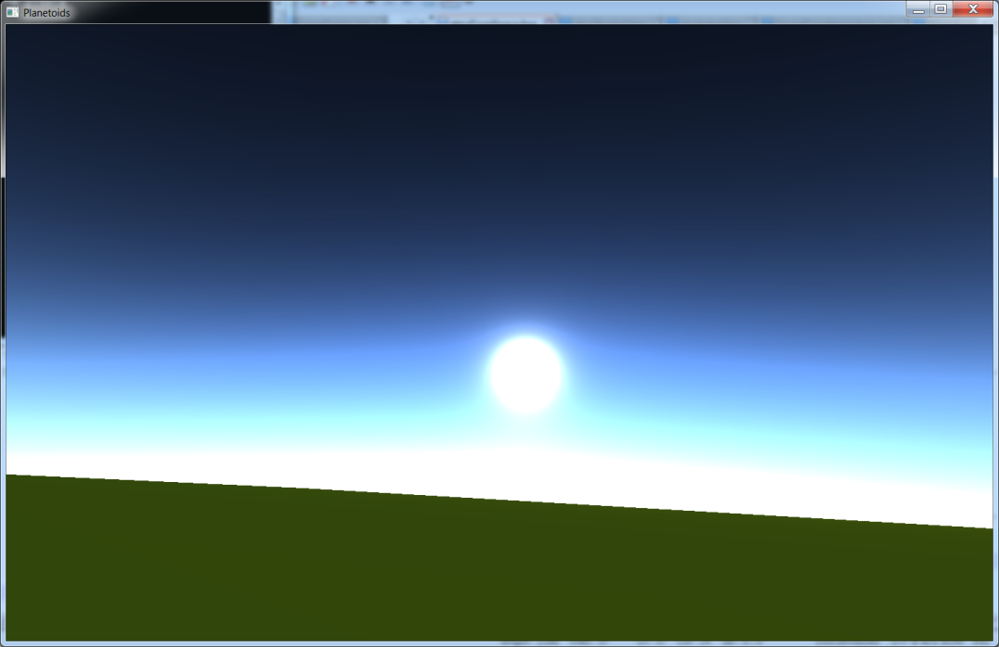

Slide 18
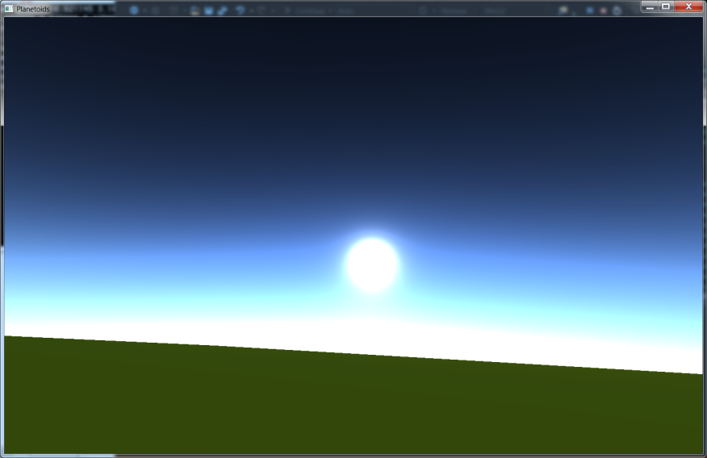
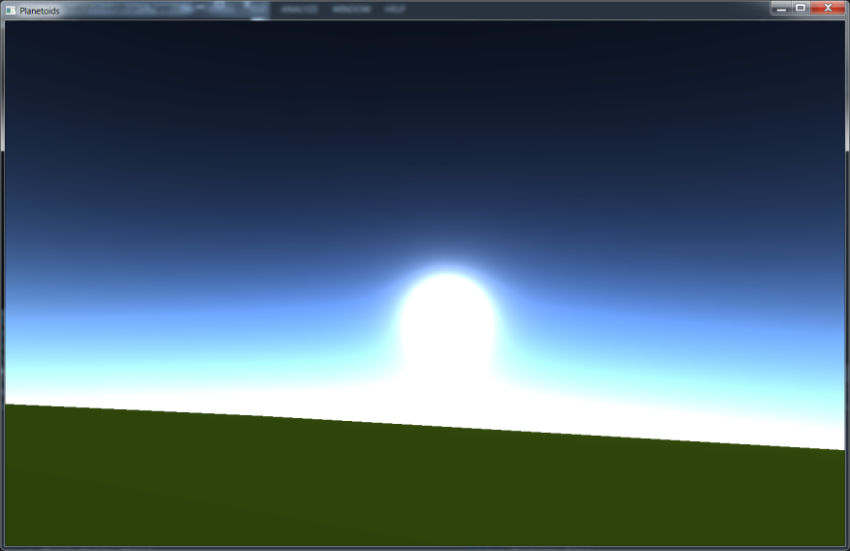
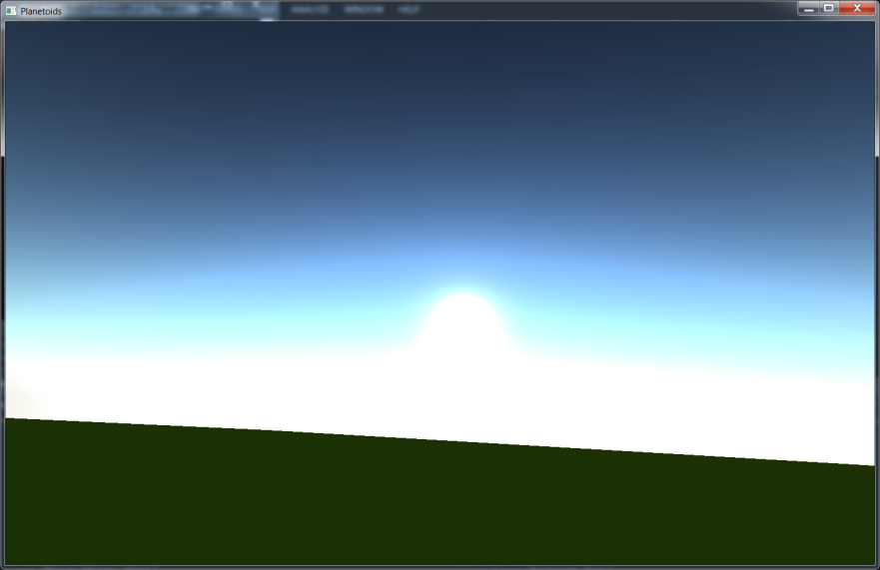
1) Default Variables
2) High Km Value
3) High Kr Value

